Slide 1
Chapter 4
Introducing Classes, Objects, and Methods
Copyright © 2013 by The McGraw-Hill Companies, Inc. All rights reserved.

Slide 2
Class Fundamentals
Classes are templates or blueprints that specify how to build objects.
Objects are instances of a class.
A class can be used to create any number of objects, all of the same form, but possibly containing different data.
Well-designed classes group logically connected data with methods for acting on that data.
Copyright © 2013 by The McGraw-Hill Companies, Inc. All rights reserved.

Slide 3
Class General Form
class classname {
// declare instance variables
type varname;
// declare constructors
classname( parameters ) {
// body of constructor
}
// declare methods
type methodname( parameters ) {
// body of method
}
}
Copyright © 2013 by The McGraw-Hill Companies, Inc. All rights reserved.

Slide 4
Class General Form explanation
Collectively, the methods and variables defined within a class are called
  members of the class
Variables defined within a class are called instance variables
  because each instance of the class contains its own copy of these variables
Copyright © 2013 by The McGraw-Hill Companies, Inc. All rights reserved.

Slide 5
Example of a Class
Vehicle class declaration:
class Vehicle {
int passengers, fuelCap, mpg;
}
VehicleDemo class declaration:
class VehicleDemo{
public static void main(String[] args) {
Vehicle van = new Vehicle();
Vehicle car = new Vehicle();
car.mpg = 25;
car.fuelCap = 12;
}
}
Copyright © 2013 by The McGraw-Hill Companies, Inc. All rights reserved.

Slide 6
Object Creation
First, you must declare a variable of the class type
This variable does not define an object ; Instead, it is simply a variable that can refer to an object
Second, you must acquire an actual, physical copy of the object and assign it to that variable. You can do this using the new operator
The new operator dynamically allocates memory for an object and returns a reference to it:
Vehicle van ; // declare reference to object
van = new Vehicle(); // allocate a Vehicle object OR
Vehicle van = new Vehicle();
Copyright © 2013 by The McGraw-Hill Companies, Inc. All rights reserved.

Slide 7
Reference Variables
The local variables van and car refer to different objects.
Both objects have the same form (with 3 instance variables passengers, fuelCap, and mpg), but they have their own copies of the 3 instance variables.
To access instance variables and methods, use the dot (.) operator:
car.mpg = 25;
car.fuelCap = 12;
Copyright © 2013 by The McGraw-Hill Companies, Inc. All rights reserved.

Slide 8
Assignment of References
If you assign
van = car;
then both variables refer to the same object.
In that case, if you change an instance variable's value in van, it will change the value in car as well, since they refer to the same object.
The object that van previously referred to is garbage collected if no other references to the object exist.
Copyright © 2013 by The McGraw-Hill Companies, Inc. All rights reserved.

Slide 9
Assignment of References
Note:
When you assign one object reference variable to another object reference variable,
you are not creating a copy of the object, you are only making a copy of the reference

Slide 10
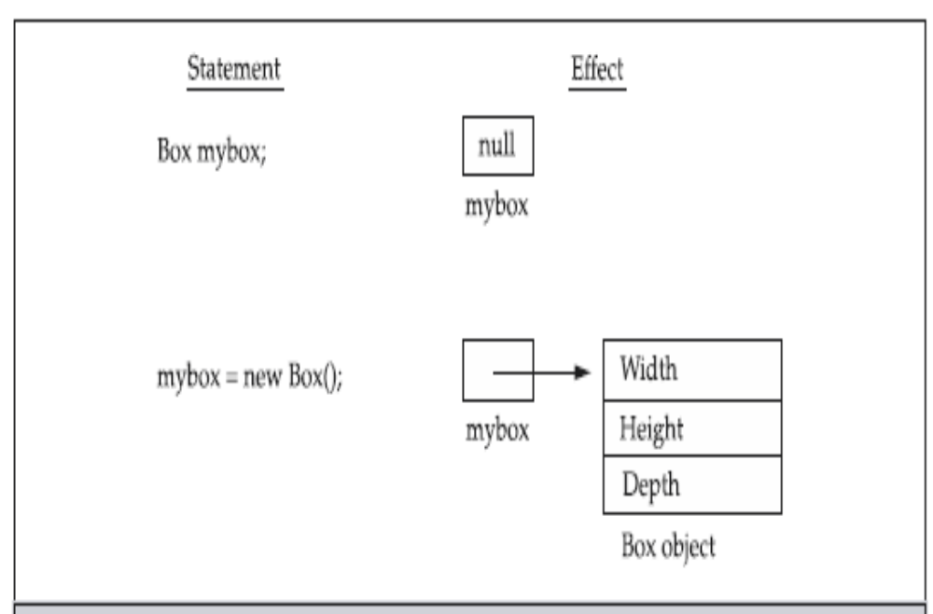

Slide 11
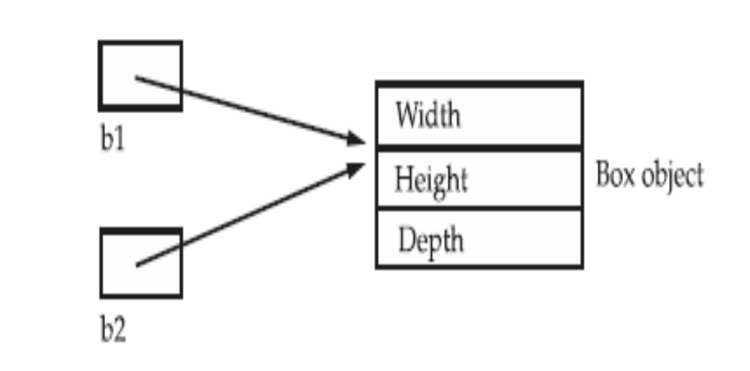
  Box b1 = new Box();
  Box b2 = b1

Slide 12
Methods
General form:
  return-type methodname ( parameters ) {
  statements;
  }
Parameters are local variables that receive their values from the caller of the method.
The return type can be any valid type or void if the method doesn't return a value.
Copyright © 2013 by The McGraw-Hill Companies, Inc. All rights reserved.

Slide 13
Example Method
The following method can be added to the Vehicle class:
void range() {
System.out.println("range: " + fuelCap * mpg);
}
If the VehicleDemo class's main( ) method calls
car.range();
then "range: 300" will be displayed.
Copyright © 2013 by The McGraw-Hill Companies, Inc. All rights reserved.

Slide 14
Returning from a void Method
Two ways to return from a void method:
  when the method's closing brace is encountered
  when a return statement is encountered
Examples:
void sayHello() {
System.out.println("Hello");
}
void sayHello() {
System.out.println("Hello");
return;
}
Copyright © 2013 by The McGraw-Hill Companies, Inc. All rights reserved.

Slide 15
Returning a Value
To return a value from a method, you must use a return statement of the form:
  return value;
Example:
  In the Vehicle class:
int range() {
return fuelCap * mpg;
}
  In VehicleDemo class's main( ) method:
int range = car.range();
System.out.println(range); // prints "300"
Copyright © 2013 by The McGraw-Hill Companies, Inc. All rights reserved.

Slide 16
Using Parameters
A parameter is a variable whose scope is the method body and whose initial value is specified by the caller.
Example:
  In the Vehicle class:
double fuelNeeded(int distance) {
return (double) distance / mpg;
}
  In VehicleDemo's main( ) method:
System.out.println(car.fuelNeeded(750));
// prints "30.0"
Copyright © 2013 by The McGraw-Hill Companies, Inc. All rights reserved.

Slide 17
Constructors
Used to initialize an object when it is created
Syntactically it is like a method.
Its name is the name of the class.
Have no return type, not even void
Automatically called when an object is created.
Example constructor for Vehicle class:
Vehicle() {
fuelCap = 12;
mpg = 25;
passengers = 5;
}
Copyright © 2013 by The McGraw-Hill Companies, Inc. All rights reserved.

Slide 18
Default Constructors
Consider
Vehicle van = new Vehicle();
new Vehicle() is calling the Vehicle() constructor
When you do not explicitly define a constructor for a class, then Java creates a default constructor for the class
The default constructor automatically initializes all instance variables to zero

Slide 19
Constructors with Parameters
Example:
  In the Vehicle class:
  Vehicle(int p, int f, int m) {
  passengers = p; fuelCap = f; mpg = m;
  }
  In the VehicleDemo's main( ) method:
  Vehicle car = new Vehicle(5, 12, 25);
  Vehicle van = new Vehicle(7, 24, 21);
Copyright © 2013 by The McGraw-Hill Companies, Inc. All rights reserved.
Notes:
fuelCap: fuel capacity in gallon
Mpg: miles per gallon

Slide 20
The Keyword this
this is an implicit argument that refers to the object on which the method is called.
this is useful for making it clear that you are referring to an instance variable.
Example in Vehicle class:
double fuelNeeded(int distance) {
return (double) distance / this.mpg;
}
Copyright © 2013 by The McGraw-Hill Companies, Inc. All rights reserved.

Slide 21
Instance variable hiding
It is illegal in java to declare two local variables with the same name inside the same or enclosing scopes.
Interestingly, you can have local variables, including formal parameters to methods, which overlap with the names of the class instance variables. We can see the following example for this explanation.
Example:
  Vehicle(int p, int f, int m) {
  passengers = p; fuelCap = f; mpg = m;
  }

Slide 22
Instance variable hiding
However, when a local variable has the same name as an instance variable, the local variable hides the instance variable. This is why passengers, fuelCap, mpg were not used as the names for the parameters to the Vehicle() constructor inside the Vehicle class. If they had been, then passengers would have referred to the formal parameter, hiding the instance variable passengers.
Example:
Vehicle(int passengers, int f, int m) {
passengers = passengers; // passengers refers to formal parameter
fuelCap = f;
mpg = m;
}

Slide 23
Instance variable hiding
While it is usually easier to simply use different names, there is another way around this situation. Because this lets you refer directly to the object, you can use it to resolve any name space collisions that might occur between instance variables and local variables.
// Use this to resolve name-space collisions.
Vehicle(double passengers, double fuelCap, double mpg) {
this. passengers = passengers;
this. fuelCap= fuelCap;
this.mpg = mpg;
}

Slide 24
Progress Check
What is the difference between a class and an object?
How is class defined?
What two things does a class contain?
What does new do?
Each object has its own copies of the class’s _________
What is this?
When is a constructor executed?
Does a constructor have a return type?
Can a constructor have one or more parameters?
What happens when one reference variable is assigned to another?

Slide 25
Garbage Collection
In some languages, such as C++, dynamically allocated objects must be manually released by use of a delete operator
Java takes a different approach; it handles deallocation for you automatically
The technique that accomplishes this is called garbage collection
Copyright © 2013 by The McGraw-Hill Companies, Inc. All rights reserved.

Slide 26
Garbage Collection
When no references to an object exist,
  that object is assumed to be no longer needed, and the memory occupied by the object can be reclaimed
There is no explicit code needed to destroy objects as in C++

Slide 27

The finalize( ) Method
Sometimes an object will need to perform some action when it is destroyed
For example, if an object is holding some non-Java resource such as a file handle or window character font,
  then you might want to make sure these resources are freed before an object is destroyed

Slide 28
The finalize( ) Method
By using finalization, you can define specific actions that will occur when an object is just about to be reclaimed by the garbage collector
To add a finalizer to a class, you simply define the finalize( ) method
Inside the finalize( ) method you will specify those actions that must be performed before an object is destroyed

Slide 29
The finalize( ) Method
The finalize( ) method has this general form:
protected void finalize( )
{
// finalization code here
}
The keyword protected is a specifier that prevents access to finalize( ) by code defined outside its class
Copyright © 2013 by The McGraw-Hill Companies, Inc. All rights reserved.

Slide 30
The finalize( ) Method
It is important to understand that finalize( ) is only called just prior to garbage collection
It is not called when an object goes out-of-scope, for example
This means that you cannot know when—or even if—finalize( ) will be executed
Therefore, your program should provide other means of releasing system resources, etc., used by the object
Copyright © 2013 by The McGraw-Hill Companies, Inc. All rights reserved.

Slide 31
Exercise
Q1. Define a class to represent a complex number called Complex. Provide the following member functions:-
i. To assign initial values to the Complex object (using constructor).
ii. To display a complex number in a+ib format.
Write a main function to test the class.
Q2. Create a Swapper class with two integer instance variables x and y and a constructor with two parameters that initialize the two variables. Also include three methods: a getX( ) method that returns x, a getY( ) method that returns y, and a void swap( ) method that swaps the values of x and y. Then create a SwapperDemo class that tests all the methods

